Slide 1
Okawa Symposium 2018
Solvable Challenges
David J. Kuck
Mar. 8, 2018

Slide 2
Essence of understanding computer systems
Status today
Reliance on intuition is too frequent
  When distinct analyses give conflicting results, no easy resolution
    → wet finger in wind decisions
  New systems surprise, always need post-Si analysis/ enabling
2. Where should one look in massive data sets?
  How to combine field measurements with instruction-level lab data?
  Tool speeds have limited usability → built fast models → new tools
3. Localize perf and energy issues: architecture-node per codelet
4. Advise people based on individual world-views
  What are you willing to change: buy system, fix SW, design system
  What should be changed to satisfy world-view: energy, performance
  How to improve – many paths to success – sometimes hidden
Need tools
New results

Slide 3
Overview: Improving developer tool value
Understand and improve Quality of computation = SW + data + system insight
Tools must deal with whole workloads: codes + various data sets
Focus program analysis → time, D-size, path → Qprofile
Quality prof(time, power, ops): accept user inputs – give meaningful outputs
How to go deeper → HW/SW codesign tools
Target is knowledgeable HW/SW developers, balancing intuition with new-tool use;
Premise is that better tools will shift the balance to:
deeper tool use and higher level intuitive decisions.

Slide 4
Outline of talk
We discuss understanding and improving: SW, systems, and computations
A. Where to start → improve current analysis tools
  Workload analysis for Quality (performance, energy) → New profiling: Qprof
  Qprof provides new insights about SW/system/computation
B. Interpretation of Qprof results → tool user inputs - outputs
  What-If tradeoffs – e.g., which scalar codelets could benefit from vectorizing
  Policy goals sought: max (speed) or max (speed/energy)? power or rate limits?
C. Status of systems and computations over past decade
  Survey of SPEC and HPC server gains
  DCA client PC analysis
D. How to go deeper → HW/SW codesign tools based on new models
  Extensions to current intuitive approaches
  Automatic constrained optimizations

Slide 5
Computational Quality (Q) definitions
Many possible Q functions of time, operations, power, energy, costs, etc.
We start with computational capacity = C[ops or work units/sec], Energy [joules]
  Consider a codelet and data set (D) = codex
  C(BW, Latency, storage Size)=O/t, E(B,L,S)=Wt; both from: system + codex → computation
Q=C/E allows comparison of various kinds of computations
  C as a rate can compare dissimilar apps, various work units – insts, pixels, frames, jobs
  Low energy is desirable, if C is high enough to satisfy users
Policy: Max Q, subject to limit constraint, can cover many situations
  Constraints: power upper limit (servers, PC battery life), rate lower limit (frames/sec)
  Satisfy user desires by applying distinct policy per job

Slide 6
A. Where to start in HW/SW/arch analyses
Time profile ignores D-size, execution instances, energy used
Codex = <codelet, D-size>: Cluster by “common” D-sizes (e.g. L2, L3, RAM)
  Suppose Tprof finds that Cx runs T sec = 20% of total app; what to do?
  Qprof shows that .5 T runs @ instance1 3X3 arrays, .5T @ instance2 300X300 arrays, which can focus attack. [hint: 300X300 exceeds L2 size]
  Consider easier case where codelets Cx and Cy each run for 10% of total app time T sec
High Q includes E and t. Q varies among codexes and instances/codelet
  Domain-specific C: Cvideo[frames/sec], CHPC[expoflops, solns/hr], C[transacts/sec]
  300X300 instances may yield lower time and E/access by loop blocking
Tprofiles have long tails: only the first 1/3 may be too much to study
We want lumpy profiles that indicate important commonalities and indicate plausible mitigation → focus on parts of top 2/3 → Foil example

Slide 7
Profiling potential: Tprof +
Time profile
Rank order | 1 | 2 | 3 | 4 | 5 | 6 | … |  | n
% time | 10 | 8 | 6 | 5 | 4 | 3.5 |  |  | .01
tName/codelet | C1 | C2 | C3 | C4 | C5 | C6 |  |  | Cn
Work on top 33% t
Eliminating 1/3 would get 11% gain;
But where does one start?
Hot spots not identical?
Maybe find max 5% gain?
Time profilers give SW views, by sorted loop times, call tree, etc.
Also HW-centric metrics – CPI, cache misses, L3 writebacks, … Meaning/insight?
Weak overall insight; action burden is entirely on motivated developers.
Developers add functionality, don’t understand systems → motivation gap

Slide 8
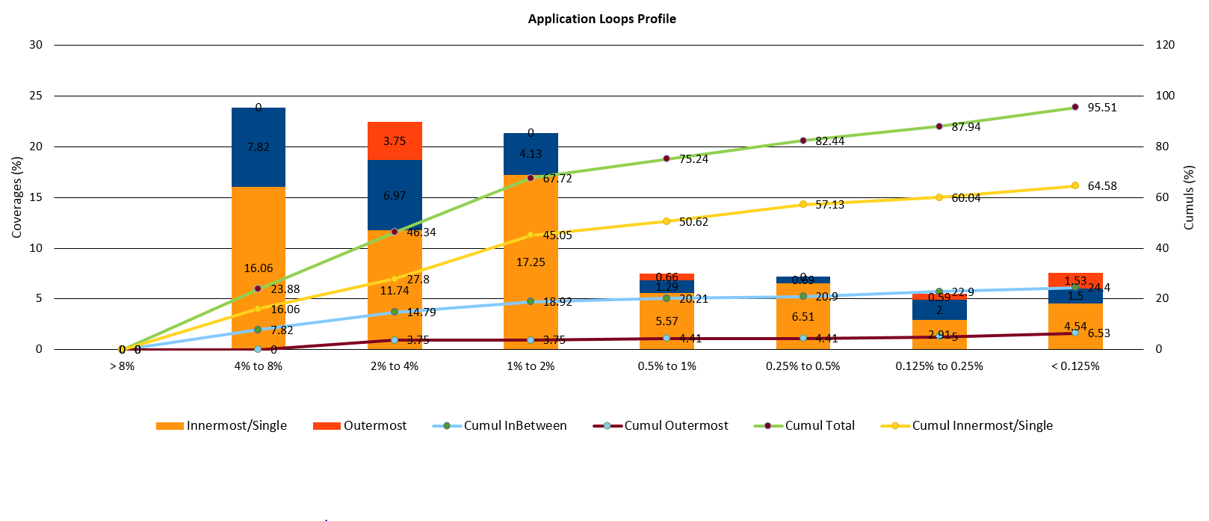
OneView profile of Yales2 CFD – 3D_cylinder
26 innermost loop codelets give 50% time coverage
Nbr of inner loops 3 4 11 8 19 16 91

Slide 9
Profiling potential – execution instance quality
Three levels of possible tools
Qinstance profile; hierarchy of views
Rank order | 1 | 2 | 3 | 4 | 5 | 6 | 7 | ... | n
% time | 6 | 5 | 4 | 3 | 2.5 | 2.5 | 2.5
t/Qname | C1,1 | C2,1 | C1,2 | C5,1 | C9,1 | C2,2 | C3,1
Q=C/E | low | medium | high | medium | medium | high | low
Acceptable |  |  | L2, vect |  |  | L3, vect
Actionable | L2, scal | Ram, vect |  | Div, sc | SB, vect |  | L3, scal
Concern | Capacity | Energy, C | NA | E,C | E,C | NA | C
Action ideas | vectorize | Block to L3 | NA | alg / vect | fuse loops | NA | vectorize
1. Measure & display t, ops, E,Q / instance
2. Problems & possible meanings
3. Possible mitigations
Codex = <codelet i, data set j> ← {Ci,j}
C1 is partially vectorized, small D, many calls
C2 is vectorized, large D
C3 is scalar
C5 is scalar; can div be changed?
Colors represent lumps in profile 25.5%t
Dismiss 6.5%
Target 19% (likely success for half or more?)
Expert developer gets 16.5%
User gets 2.5% (or more if willing to recompile)
Analysis of Qinst prof can lead to fixes by type: less user work, higher likelihood of success

Slide 10
To overcome gaps we need new ‘micro’scopes
Focus on arch nodes and SW instance-level details (impossible via counters)
Model gives accurate estimates for L2, L3, RAM resident data.
  Current tools (e.g. vector analyzers, assume L1 accesses)
Energy counter gives total package energy, needs msecs. to get readings.
  How can we refine that?
  Use Energy model coefficients and arch traffic counters. See next foil.→
Results useful in: fixing SW problems, syst selection, & codesign tools.

Slide 11
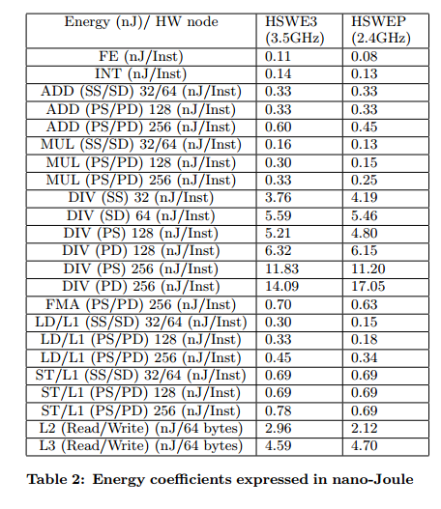
Node-level energy model, per instruction
Haswell client and server architectures
Variation across instructions
Variation among two “similar” architectures
E varies during computation with node power and t.
We have an iterative procedure [Emodel] to build such models

Slide 12
Summary of HW/SW/arch analysis
Decompose architecture to nodes: sc+, vect+, LM, LB, SB, LFB, Li, ram, …
  Capacity equations C(B,L,S) relate nodes by intensities = Ci /Cj ; SW invariants
  Accurate system models from capacities, with limiting values per codelet
Decouple problems: time, power, capacity, etc.
  Measure one node by ignoring all other nodes; accurately by repetition outer loops
Fast deep analysis tools: energy/node, perf limiter node/codelet, …
  Separate causes (prognostics, e.g. CU buffer stalls) from effects (diagnostics, e.g. L3 misses)
Integrate results, e.g. Qprof with various views/ levels
Show results in response to user interests and needs → Sects. B. and D.

Slide 13
B. Acting on Qprof results interactively
But, do we always want to vectorize, or even go as fast as possible?
  How much will vectorization help this code? → VP3 foil
    Sort out low-potential cases → wasted work
    Other transformations possible, e.g. loop blocking
  Does fastest mean least energy? Or best quality? No
    E = Wt, so if power were constant, it would,
  but W varies depending on HW use, and so does time.
    So Race to Halt is easy to beat; better approach follows user inputs and is codelet aware
Policy definition is user driven: maximize Q, s.t. constraint limit
  Where Q=C, C/E, C/W=O/E, etc. and limit =Wlimit or =Climit , etc.
  Max C/E s.t. Wlimit → Policy foils
  Apply per codelet by using hidden architecture choices <(f,V), inst set, pref, #cores>

Slide 14
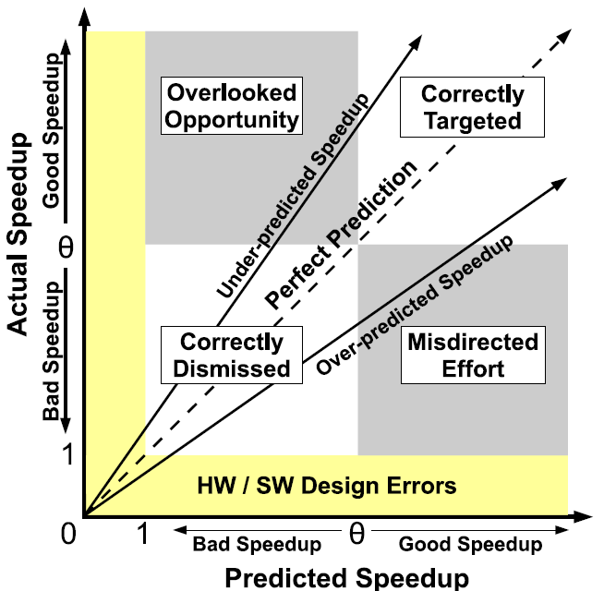
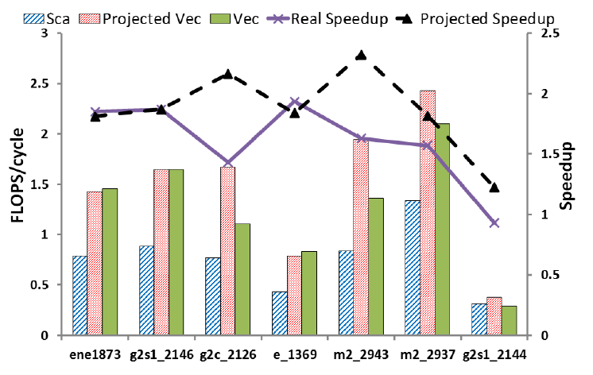
Vector potential VP3, ignoring semantics
Polaris, molecular dynamics, started scalar due to roundoff concerns. VP3 showed potential → Directives on 40 loops gave 1.5X app-level speedup. One VP3 error: g2c
VP3 operation. Set performance threshold (theta=1.2 here), run tool with real data. Results ignore dependences, etc., so may have errors.

Slide 15
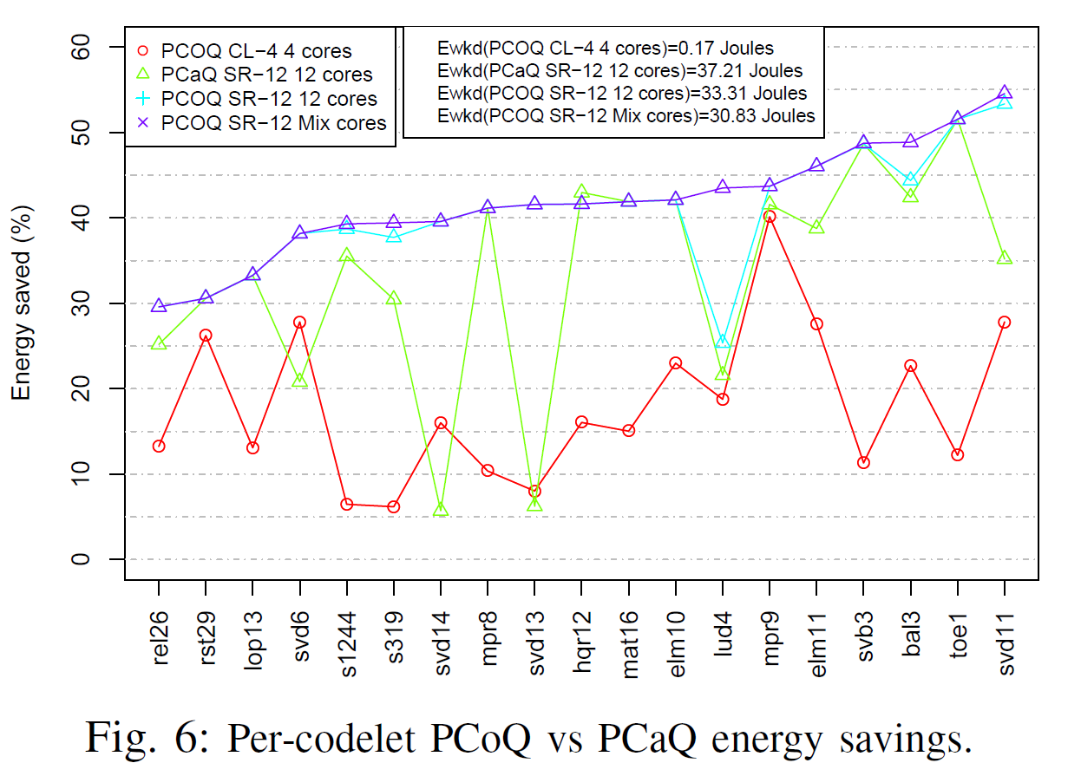
Policy tool PCOQ (opt), PCaQ (approx.) Esave v. RTH – D(ram)
Normalize to RTH
40% package wrkld-power saved, less than 4% performance loss (depends on Dsize)

Slide 16
Max C/E s.t. Wlimit using 12 core HSW, NR codelets @2.3 GHz
Policy tool PCOQ (optimal) output
Code | Sc/VEC | Pre-fetch | Freq Core /Unc | CORES | CPI_D | P (W) | C (Gflops) | C/E | C/W | T (ms) | E (mJ) | ∆E rank
balanc_3 | SSE | On | 1800000 | 6 | 40.92 | 51.70 | 2.70 | 1.83 | 0.05 | 28.47 | 1471.53 | 3
elmhes_10 | SC | On | 1900000 | 12 | 81.85 | 61.53 | 5.40 | 3.08 | 0.09 | 28.47 | 1751.77 | 8
elmhes_11 | SSE | Off | 1900000 | 12 | 915.64 | 57.92 | 0.48 | 0.26 | 0.01 | 31.85 | 1844.58 | 5
hqr-sq_12 | SSE | On | 2300000 | 12 | 8.47 | 83.48 | 26.07 | 35.82 | 0.31 | 8.72 | 727.77 | 10
lop_13 | SSE | On | 2000000 | 12 | 84.08 | 67.60 | 21.01 | 34.71 | 0.31 | 8.96 | 605.37 | 17
ludcmp-sq_4 | AVX2 | On | 2000000 | 10 | 93.09 | 62.35 | 7.91 | 1.10 | 0.13 | 114.98 | 7169.28 | 7
matadd-flb_16 | SC | On | 1900000 | 12 | 92.74 | 62.87 | 2.38 | 3.79 | 0.04 | 9.99 | 628.22 | 9
mprove_8 | AVX2 | On | 2.1/2.3 | 12 | 17.53 | 77.57 | 50.37 | 133.10 | 0.65 | 4.88 | 378.46 | 12
mprove_9 | SC | On | 1800000 | 12 | 84.98 | 58.20 | 2.60 | 1.51 | 0.04 | 29.56 | 1720.36 | 6
relax2_26 | SSE | On | 2.1/2.3 | 12 | 70.27 | 75.49 | 10.21 | 1.48 | 0.14 | 91.54 | 6910.31 | 19
rstrct_29 | SC | On | 2.1/2.3 | 12 | 105.66 | 74.51 | 12.54 | 14.91 | 0.17 | 11.29 | 841.00 | 18
s1244 | AVX2 | On | 1900000 | 10 | 72.81 | 60.32 | 15.16 | 27.57 | 0.25 | 9.12 | 549.88
s319 | AVX2 | On | 1800000 | 10 | 151.32 | 57.94 | 9.73 | 17.72 | 0.17 | 9.47 | 548.89
svbksb_3 | AVX2 | On | 2200000 | 10 | 28.04 | 77.81 | 52.49 | 144.07 | 0.67 | 4.68 | 364.32 | 4
svdcmp_11 | SC | Off | 1800000 | 10 | 136.80 | 53.69 | 0.34 | 0.27 | 0.01 | 22.84 | 1226.20 | 1
svdcmp_13 | SSE | On | 1800000 | 12 | 85.00 | 55.78 | 7.79 | 4.73 | 0.14 | 29.56 | 1649.07 | 11
svdcmp_14 | AVX2 | On | 1800000 | 12 | 167.93 | 58.06 | 2.63 | 1.55 | 0.05 | 29.21 | 1695.80
svdcmp_6 | SSE | Off | 2.2/2.3 | 12 | 160.90 | 69.67 | 1.37 | 3.52 | 0.02 | 5.60 | 389.91
toeplz_1 | SSE | On | 2.1/2.3 | 12 | 45.39 | 74.97 | 19.46 | 54.80 | 0.26 | 4.74 | 355.06 | 2
Legend | Source code type
Streaming
LD access
Division
Arithmetic
~ 6-8 Hidden architectures
System responses for Qprof display

Slide 17
C. Status of technical system performance / last 10 years
SPEC-FP and –rate not increasing much, very code-dependent
  Physics at high end, chemistry at low end (+ FEA, ray tracing, …)
  10 yr. gains have 10X range, half below 3X (10 yr. “FP peak” estimate, top Xeon servers)
  These are unicore, baseline. Rate nbrs also flat/core using all cores – stress uncore.
  Hand opt changes same 5/17, yearly; median gain 15%. 4 are low-performing baseline.
Expo-flops (using ACM Bell award)
  450X peak/ 10 years, but slowing down (38X/1st 5 yrs, 12X/last 5 yrs)
    Now 10M cores, may be hard to sustain
  Efficiency dropping (30-77% first 7 yrs, 3-15% last 3)
    Codes, data, algorithms carefully chosen – how representative of real world?
    Molecular dynamics only via special HW (also worst in Spec)
Instead of rarified Exaflops, need general-use high-Q Tera/Petaflops
Use of accelerators hard to understand – GPU, FPGA, SoC IP integration

Slide 18
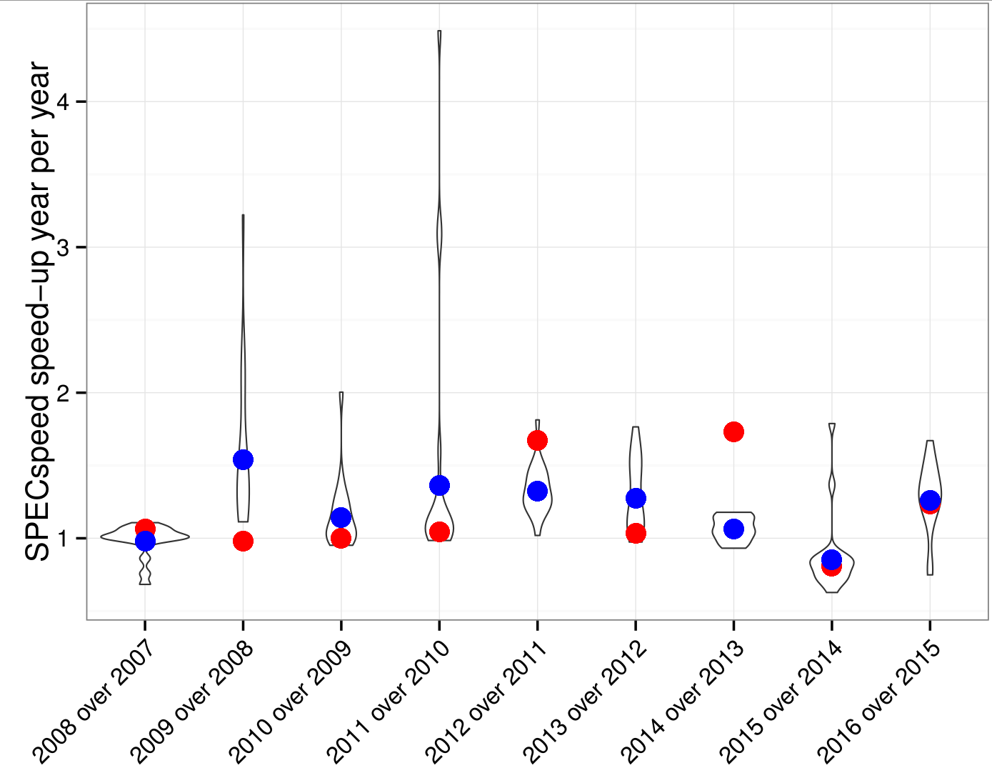
SPEC-FP performance progress in past decade
Speedup from one year to the next
Violin: distribution for the full set of SPECFP
Red Dots: speedup of peak FP performance
Blue Dots: geometric mean of Speedups
Unicore measurements
Baseline
Speedup larger than FP speedup
AVX introduction
FMA Introduction

Slide 19
More realistic view of SPEC vs “Peak” – 10 year span
Peak unicore flops increase/decade
Unicore measurements (red bars) are optimistic: one core has full access to the whole memory hierarchy. Poor speed uniformity across codes: > 10X range of perf gain/decade
SPECrate (blue bars) divided by number of cores is a more realistic view (high-end Xeon servers
Baseline numbers

Slide 20
SPEC optimized vs. baseline
Baseline: standard flags (typical –O3)
Peak: hand picked flags
Y axis: speedup of peak versus baseline – disappointing overall
X axis: sorted first by SPEC FP 2006 codes and second by year (same reference architectures)

Slide 21
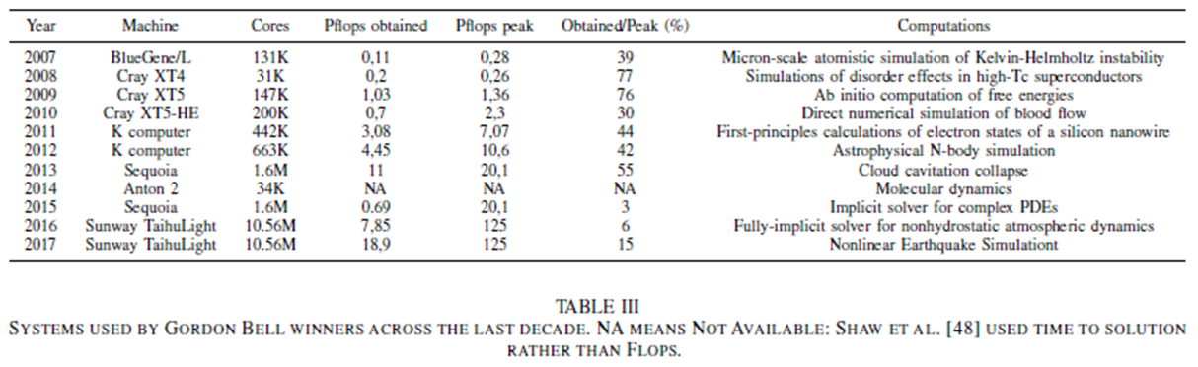

ACM Bell HPC winners/10 years
38X
446X
12X

Slide 22
D. HW/SW Codesign Options
Start by measuring real computations
  Sony-Intel Vaiocare analysis of 50M PCs – apps/SKUs/geos → personas
  Go deeper on matching designs to key workloads/ personas
Provide new insights about workload to intuition-based designers
  Now: cycle-accurate simulation of many traces – slow but exact
  Speed limits workload coverage possible
Use workload measurements with very fast models
  Whole workload simulations – fast but approximate market coverage
  Enables comprehensive What-ifs, tradeoffs
The tools above improve focus for SW or arch modification
  Use various quality metrics
  Apply SW transforms and policies before design → systems meet persona desires

Slide 23
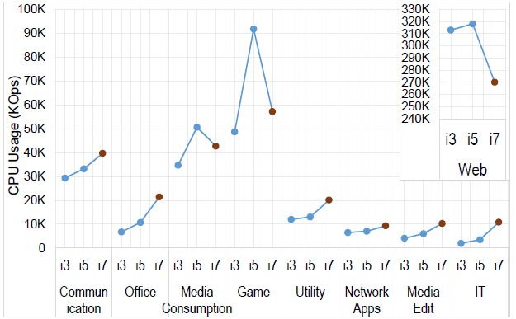
PC use of application types by i3, i5, i7 processors
50 M Sony Vaiocare systems WW (~2010 to end of Sony PCs)
Av. CPU ops/ all category users
User personas
CPU usage[ops] = Computational Capacity (CPU) [Passmark score] * time(app) [sec]
Note variations among PC app categories → User personas → CPU/persona

Slide 24
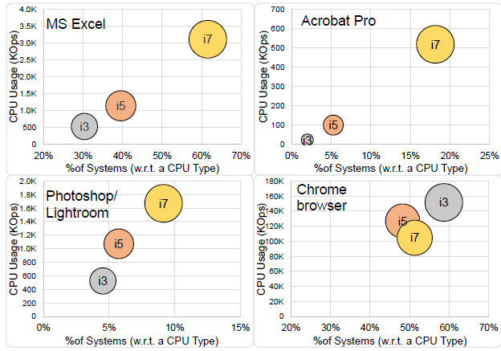
CPU type usage vs. % installed base, for several app types
Office persona
apps
Media editing persona
Web persona
Entry level i3 CPU is most used browsing; on more compute intensive apps, i7 ops 5X > i3
Design i7 for heavy ops per persona; need to analyze most used apps per category

Slide 25
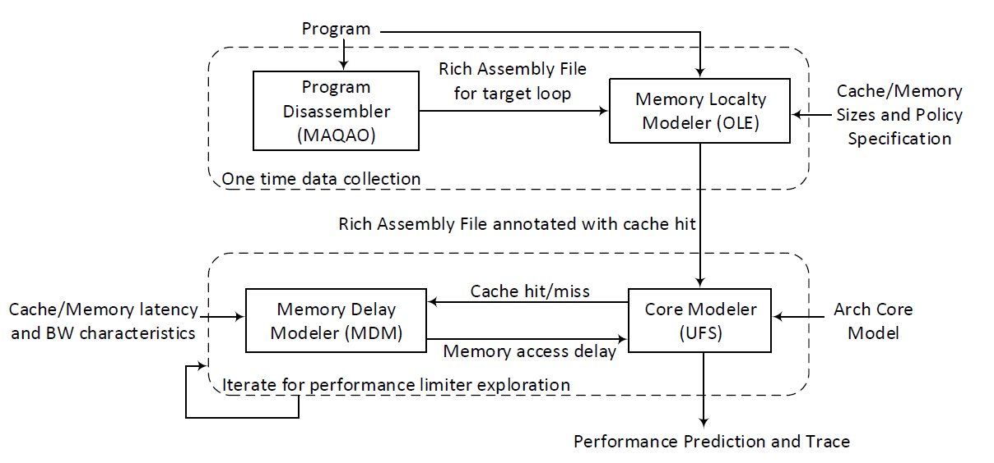
CAPE measurement and modeling
Next foil describes more details
Which of 50 system
arch nodes have computational capacities that limit
system performance?

Slide 26
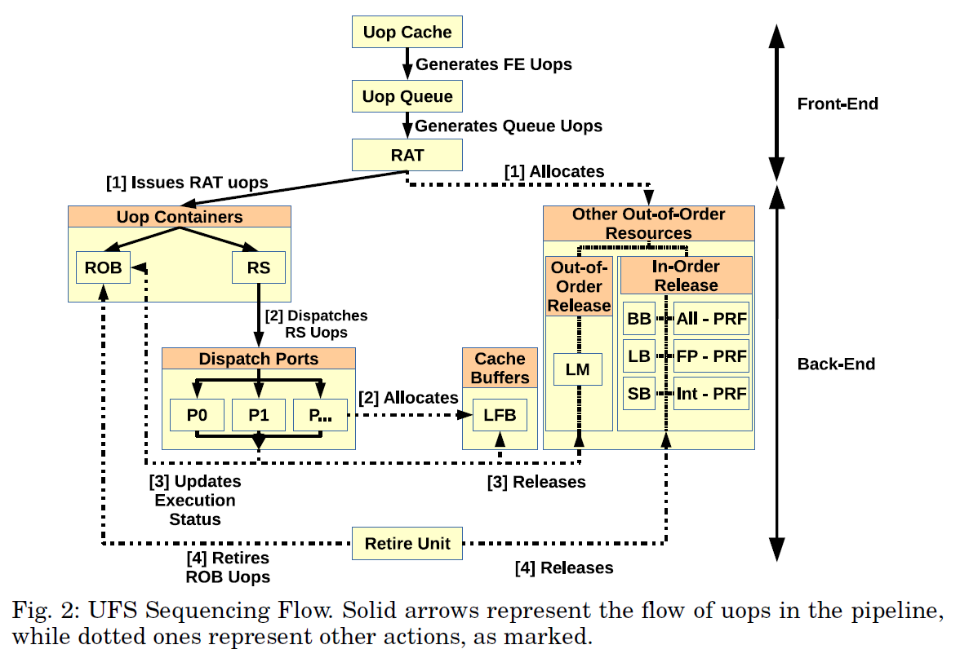
Intel Control Unit diagram
UFS simulates this at cycle level using MDM equations for memory hierarchy delays.
Micro-op flow
Backend buffer sizes can limit system performance.
Perf limiter tool detects this by varying comp cap of 50 system nodes (including CU, mem hier and ALU).
Overlaps Ld/Sto instructions

Slide 27
Many model uses
SW development tools – as above
Architecture selection – perf limiters → find a better existing system
Discover architecture change types needed
  Reduce memory hierarchy capacity C(B,L,S) delays and phys latencies
  Increase CU buffer sizes
  Increase operation BW
Earlier discussed examples of the need for UFS/MDM plus E model

Slide 28
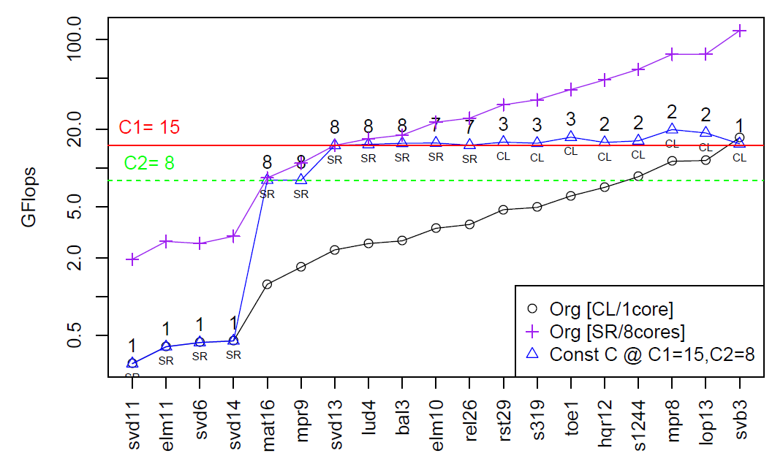
Policy-driven codesign – find rate-outliers → special HW
Optimal cases nearly const C.
C=15 OK for 13 codelets, cores 1-8. C=8 OK for 2 more codelets – 8core SR. 4 codelets need more speed.

Slide 29
Summary: 6 Solvable Challenges
A. Quality profiling of SW – Focus workload analysis –for SW tuning, system selection, or pre-Si enabling.
1. Codex selection: profile whole apps, get sufficient time coverage and define codexes using calls of each codelet with “distinct” D-sets (cluster by cache level use).
2. Codex quality analysis: Qprof ranks perf/energy (or other Q fns.), refines t profiles → top-down analyses to the codelet, D-set, arch node (uses 5).
B. Qprof analysis - Workload preprocessing – matches/optimizes SW to architecture, sets up user/owner goals for results
3. Workload improvement: VP4 transforms workload for best vectorization, cache blocking, If removal, etc.
4. Policy tool: apply to all codes and analyses, any constraints and optimization objective. Also E and t policy.
    Power: Balance vector and multicore parallelism optimally.
    Performance rate: Partition codex set among servers, or find IP blocks in a workload for rate demands.
C. Analyze and redesign system – these steps can be taken somewhat intuitively, or fully automatically
5. HW analysis per codex: Perf and Q limiters cluster codexes architecturally, explain architectural changes needed per cluster for optimization, cause/effect analyses, and codesign studies. Use results in analyses above.
6. Codesign tool: Use above to attack key problems. Iterate to optimize SW for hypothetical designs.
Start using current prototypes we have discussed

Slide 30
References
Wong, D, Vincent Palomares, Emmanuel Oseret, Zakaria Bendifallah, Mathieu Tribalat, William Jalby, David Kuck, “VP3: A vectorization potential performance prototype,” ACM WPMVP, 2015 VP3
Rashid, Al, Bijan Arbab, Bob Kuhn, David J. Kuck, “Purchase vs. Usage: PC Perspective,”IISWC15, IEEE Conf. on Workload Characterization, Sept. 2015. PC Measurements
Palomares, Vincent, David C. Wong, David J. Kuck, William Jalby, “Evaluating OoO engine limitations using uop flow simulation,” 9th Parallel Tools Workshop, Sept. 2015, Dresden, publisher Springer, 2016. UFS
Mazouz, Abdelhafid, David C. Wong, David Kuck, William Jalby, “An Incremental Methodology for Energy Measurement and Modeling,” ACM ICPE, International Conference on Performance Engineering, 2017 Energy model
William Jalby, David Kuck, Alan Malony, Michel Masella, Mihail Popov, Abdelhafid Mazouz, Long and Winding Road Towards Efficient High-performance Computing, invited paper for IEEE Proceedings, special issue on HPC, 2018. HPC overview
David J. Kuck, “The structure of computers and computations,” Wiley, 1978 Capacity model
David C. Wong, Vincent Palomares, Aleksandre Vardoshvili, Emmanuel Oseret, Vish Viswanathan, William Jalby, David J. Kuck, “Measuring and Modeling CPU Bandwidth, Latency and Dependence Performance Limiters,” in preparation CAPE System

Slide 31
Backup foils

Slide 32
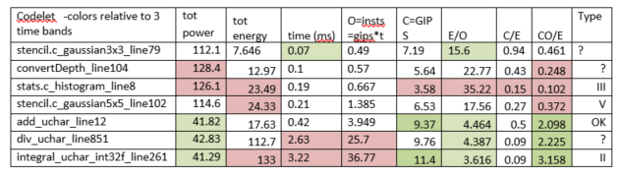
B.- 4. Qprof analysis of some OpenCV codelets
1. Sort/ partition by time bands; bottom 2 separate from above
2. Examing Q metrics for issues
Warning: ops need domain definitions
3. Dig deeper by codelet type to understand mitigation steps

Slide 33
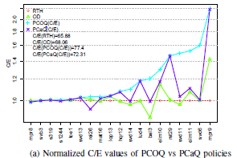
C. -2. PCOQ policy C/E vs. RTH for NR vector codelets 4-core, package measurements, L3 data, C/E(PCOQ) = C/E(DVFS) +20-30%

Slide 34
D. -5. SoC candidates: Low node saturation CFD (YALES2)
28 loops among the hottest (.5-5%) for YALES2: combustion CFD application used in academia and industry
FP (Floating Point Units), L1R (L1 Read access), L1 (L1 Write access), L2 access, L3 access
Per “node” (FP, L1R, L1W, L2, L3) and then per loop, percentage of peak bandwidth used: “saturation ratio”. Loops sorted by increasing L3 usage
Those with low saturation in all categories may be SoC candidates – need deeper examination

Slide 35
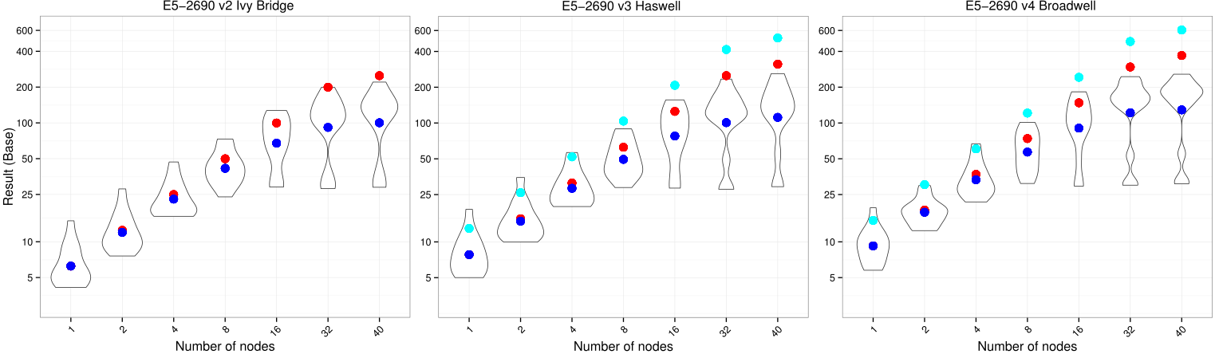
SPEC MPI PERFORMANCE PROGRESS: LAST 4 YEARS

Slide 36
Impact of cache hier. delay on codelets

